Slide 1

Data Quest2.0 Hackathon.
Presented by
Anish Thiagarajan (24BEC1334)
Tharika S (24BEC1341)
Sanjaay Srinivasan (24BCE5546)
Shamitha S A (24BRS1351)

Slide 2
Problem Statement:
A major challenge in public health is the widespread lack of access to accurate, up-to-date, and personalized health information. During disease outbreaks, this is exacerbated by a proliferation of misinformation, which can cause public confusion, panic, and behaviors that worsen the spread of illness. Existing health resources are often difficult to navigate, not available 24/7, and cannot provide tailored guidance, leading to delayed or inappropriate care-seeking and putting a strain on healthcare systems.

Slide 3




Our Approach & Solution:
Our strategy leverages AI and machine learning to deliver accurate, real-time, and personalized health information. We focus on combating misinformation, ensuring accessibility, and empowering individuals with trusted insights to support better health decisions.
Health Data Ingestion
AI Analysis
Seamlessly integrate verified health data from trusted medical and public health sources.
Detect misinformation, track disease trends, and generate real-time, evidence-based insights.
Interactive Dashboard
Actionable Recommendations
Provide 24/7 accessible, user-friendly health information with personalized guidance.
Translate insights into clear preventive measures, timely care guidance, and public health strategies.

Slide 4
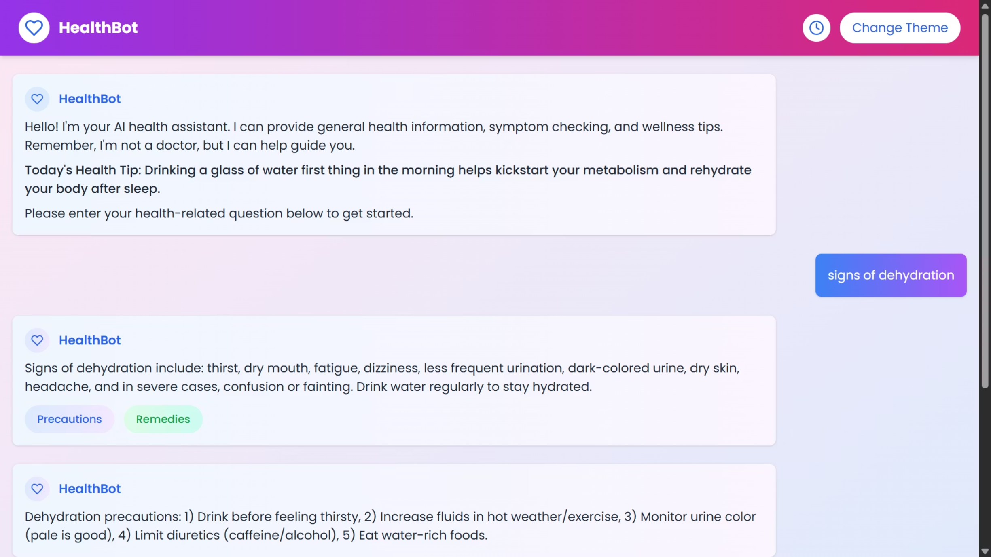

Slide 5
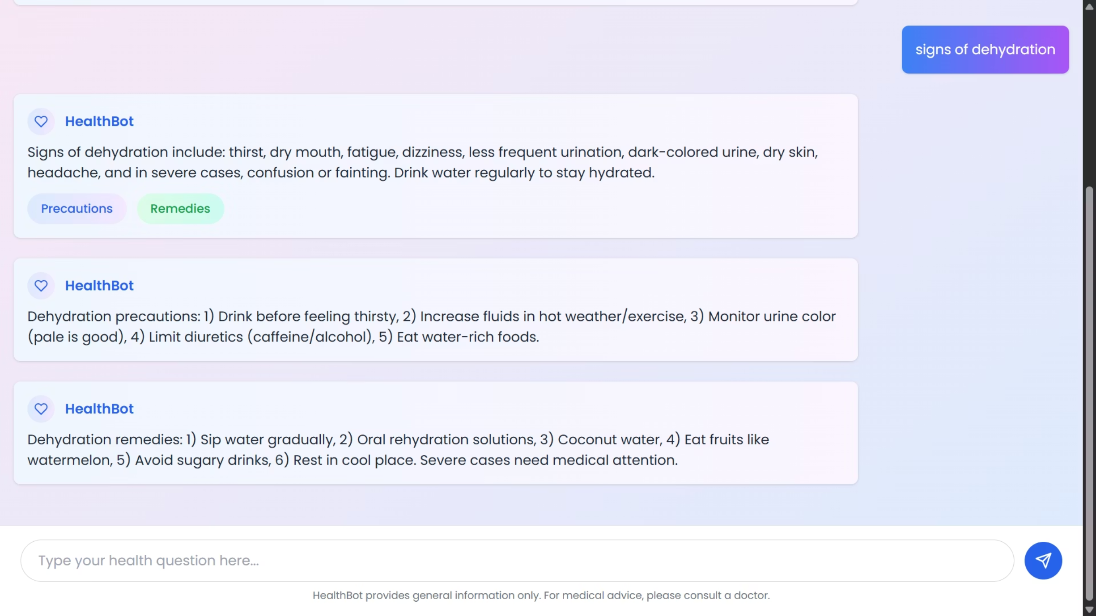

Slide 6
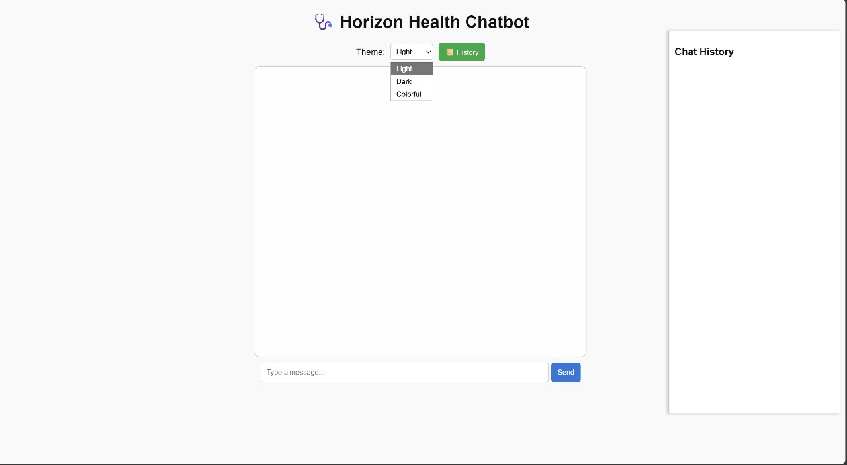

Slide 7
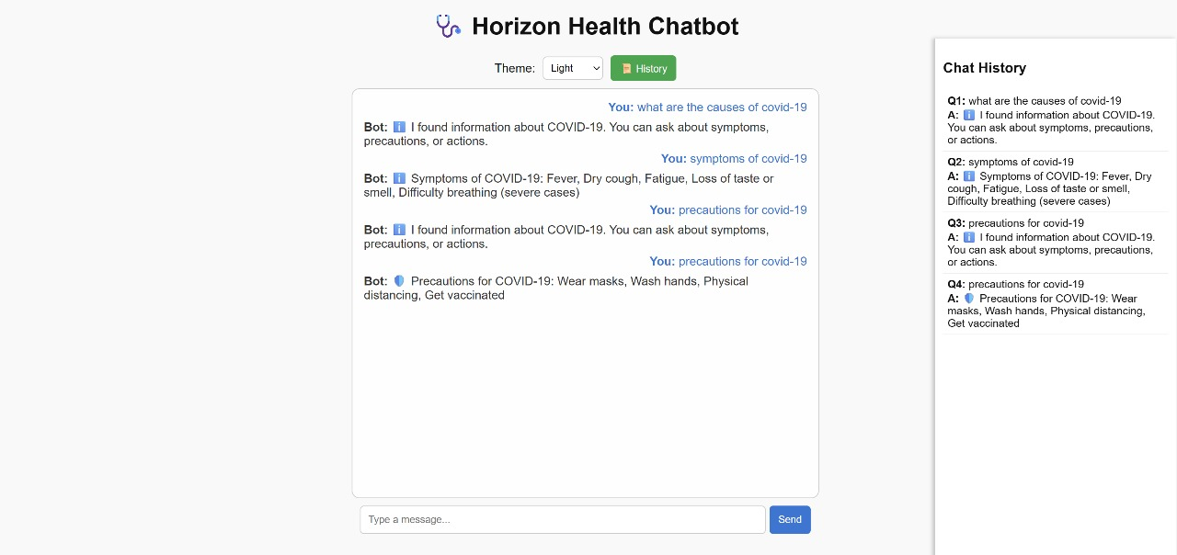

Slide 8
Thank You!
"The only way to do great work is to love what you do."
— Steve Jobs

